Slide 1
COMP6049 – Algorithm Design and Analysis
Topic 18 – Graph Coloring

Slide 2
Outline Materials
Graph Colouring
Node Colouring
Edge Colouring
Region Colouring
Chromatic number
Map colouring

Slide 3
GRAPH COLORING
Graph coloring algorithm is the classic problem of how to color a graph with different colors for each node that is "adjacent"
There is an edge connects between two nodes
Adjacency value is greater than 0
The challenge of this problem is how to get minimum number of required colors.

Slide 4
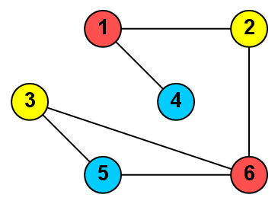
CHROMATIC NUMBER
3 colors needed to color the graph above
Minimum number of colors should be used for coloring a graph called the chromatic number.

Slide 5
PROBLEM VARIATIONS
Edge coloring
Color edge not node. Number of edges that meet at a particular node should not be given the same color.
Region coloring
Coloring piece of region, divided into small sub-region. Each sub-region which has a border should not be given the same color. This problem is more known as graph coloring.
Map coloring can be solved by turning it into graph, color the graph, and then mapped back.

Slide 6
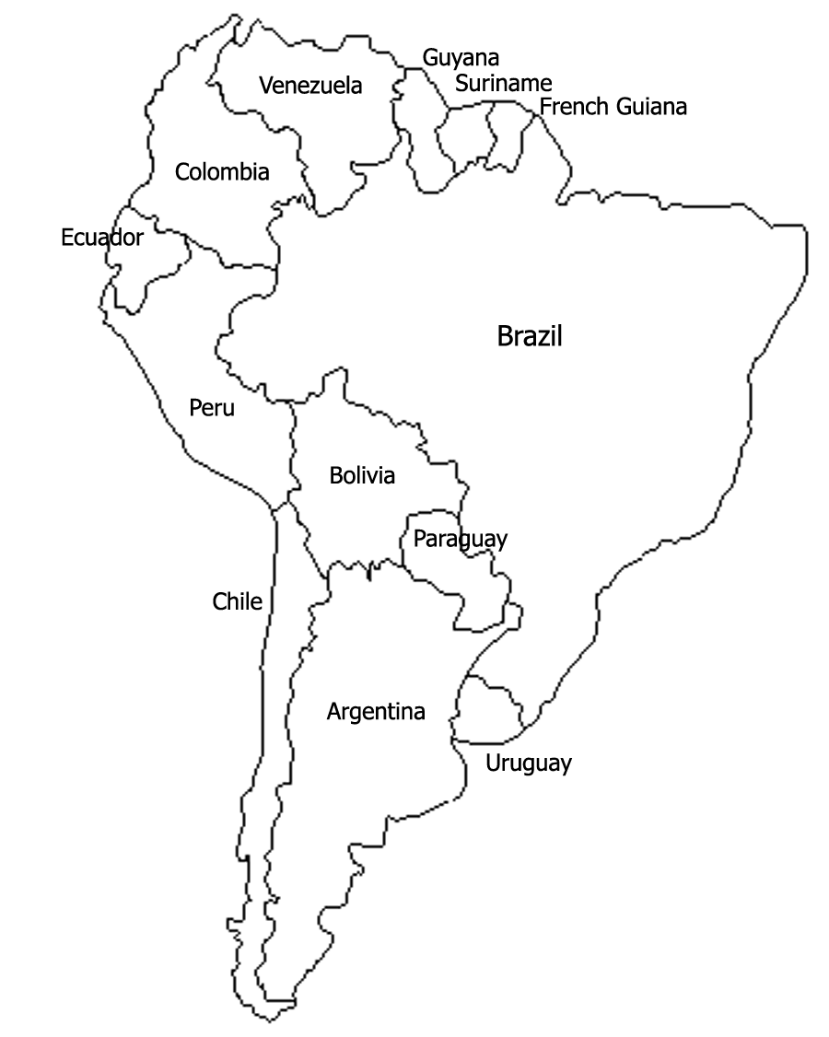
MAP COLORING

Slide 7
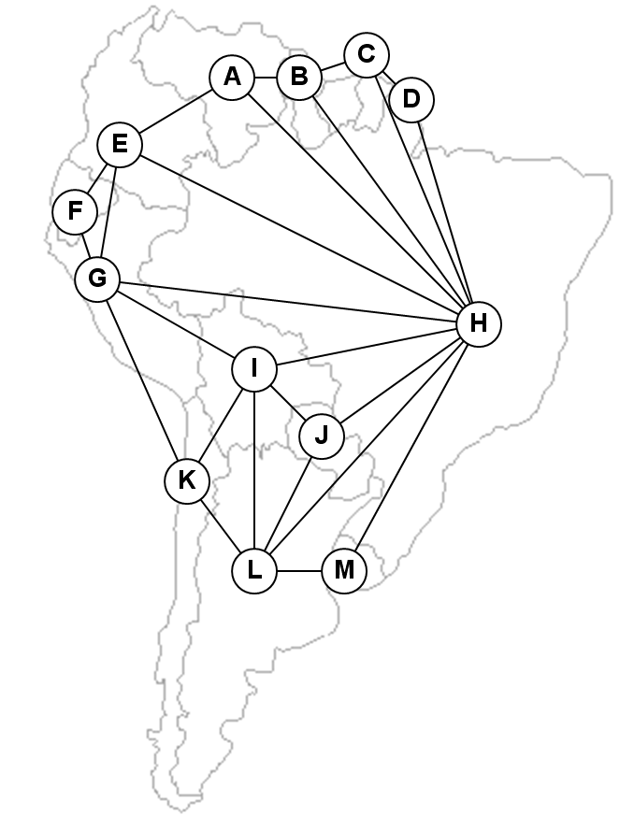
CONVERSION OF MAP TO GRAPH

Slide 8
WELSH & POWELL ALGORITHM
Sort nodes in a graph based on the number of edges connected to it, in descending order (from large to small)
Based on the above sequence, coloring all nodes in a graph with color 1 if a node is not border to a node that has been colored
Repeat this process for color 2, color 3, etc. until all nodes have been given a color
Is one example of algorithm Greedy Method
The results are not necessarily optimal
Completion optimally is NP-Complete problem

Slide 9
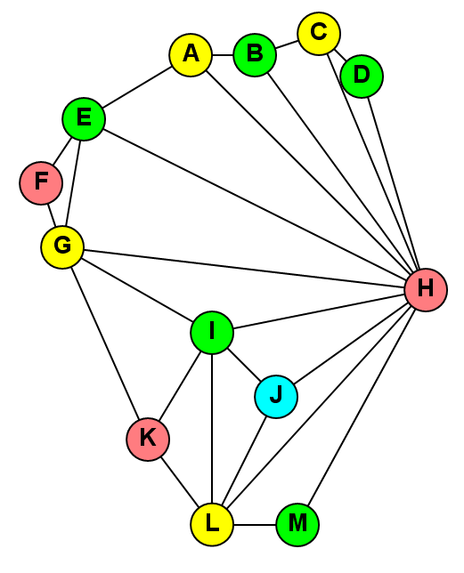
RESULTS OF GRAPH COLORING

Slide 10
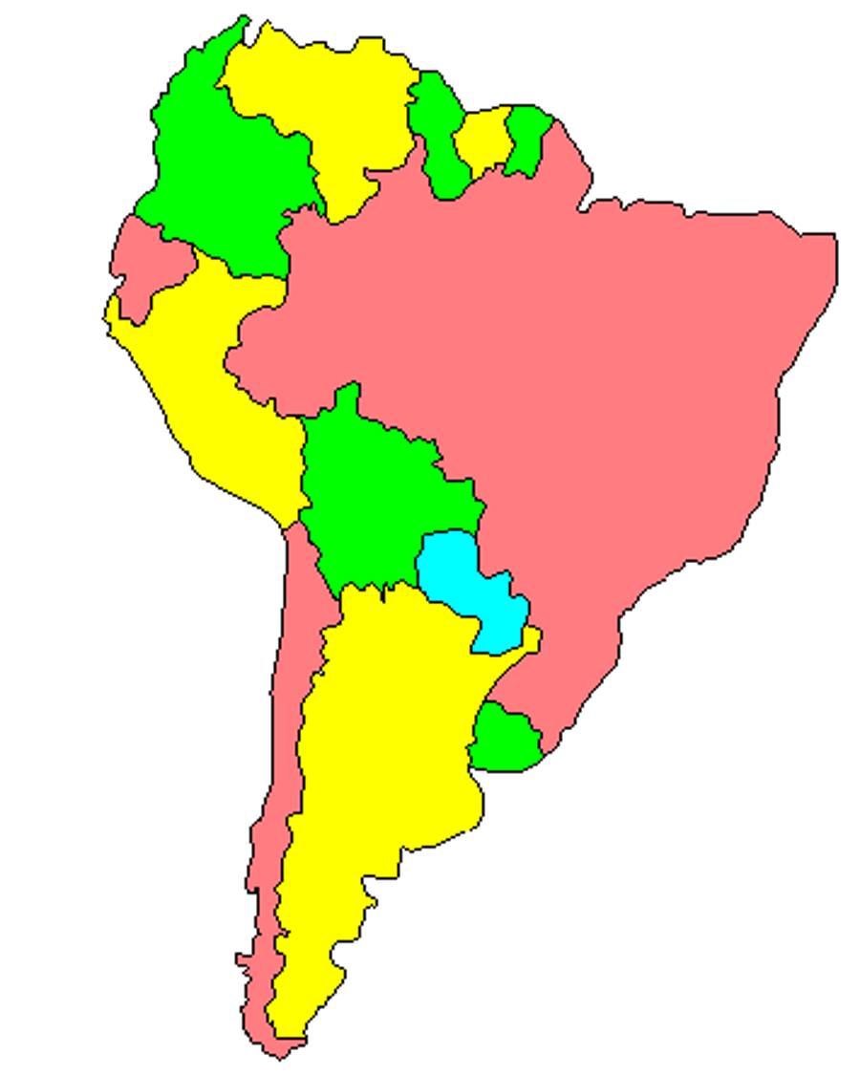
MAP COLORING
[buku utama, ilustrasi 6.12]

Slide 11
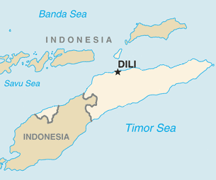
FOUR COLOR THEORM
Four Color Theorem states that every map can be colored by 4 colors or less.
This theory provides a benchmark that like any form of maps that we have, the maximum value for its chromatic number is 4.
Although never tested by using a computer, this theory can not be proven true in mathematics.
Some special cases such as no other nation which has a separate area to be one of the arguments of experts who do not believe this theory.
They adhered to the Five Color Theorem proven mathematically.

Slide 12
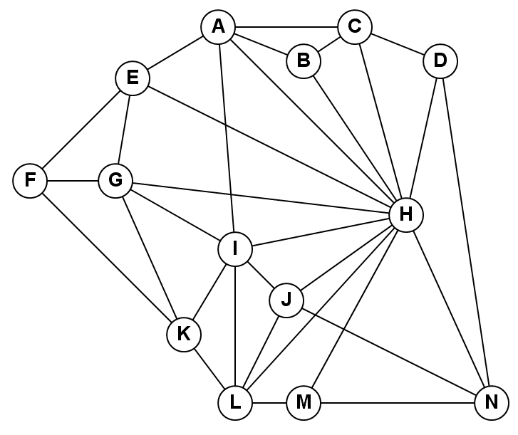
EXERCISE
Use Welsh & Powell algorithm to color the graph below!
Determine its chromatic number!

Slide 13
REVIEW
GRAPH COLORING
CHROMATIC NUMBER
PROBLEM VARIATIONS
MAPS COLORING
WELSH & POWELL ALGORITHM
FOUR COLOR THEORM

Slide 14
Q & A

Slide 15
References
S. Sridhar. 2014. Design and Analysis of Algorithms, 1/e. Oxford University Press. India. Chapter 5.6
Ellis Horowitz,Sanguthevar Rajasekaran,Sartaj Sahni. 1998. Computer algorithms/C++. 1STBL. New York. Chapter 7.4
Graph Colouring with Simple Backtracking http://blogs.msdn.com/b/ericlippert/archive/2010/07/22/graph-colouring-with-simple-backtracking-part-three.aspx

Slide 16
THANK YOU

